Slide 1
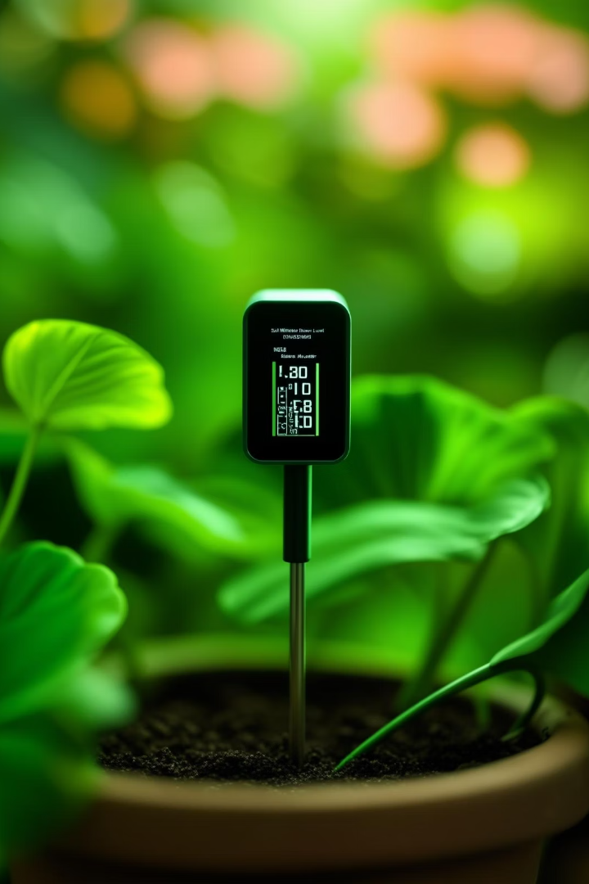
Soil Moisture Sensor With Automatic Irrigation System
This presentation explores the development of an efficient and automated irrigation system that utilizes a soil moisture sensor interfaced with an 8051 microcontroller.
By Gaurav Singh Rana 12324801 32
Sanjay Singh Chatri 12324440 31
Mohammad Idriss 12327088 30

Slide 2
The Critical Need for Efficient Irrigation
Water Scarcity
Sustainable Solutions
Global water scarcity is a pressing issue, impacting agriculture and urban environments.
Efficient irrigation systems play a crucial role in optimizing water usage, conserving precious resources, and reducing waste.

Slide 3
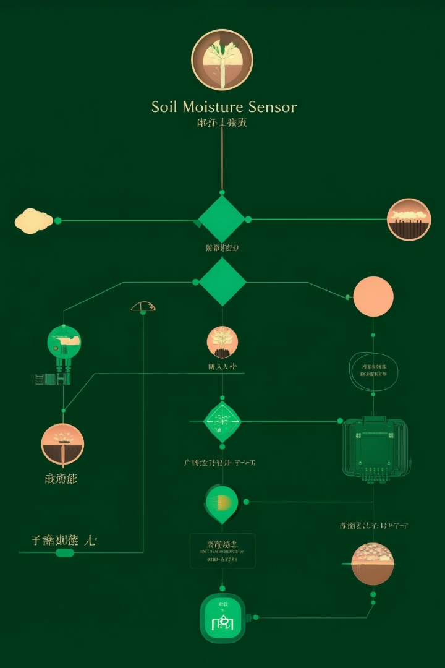
System Architecture
1
Soil Moisture Sensor
2
8051 Microcontroller
Measures the moisture level in the soil.
Processes data from the sensor and controls the irrigation mechanism.
3
Irrigation Mechanism
Delivers water to the plants based on the microcontroller's commands.

Slide 4

Sensor Calibration and Data Acquisition
Calibration
Ensuring the sensor's accuracy by establishing a relationship between its output and actual soil moisture levels.
Data Acquisition
The microcontroller regularly reads data from the sensor, interpreting the raw signal into meaningful moisture values.

Slide 5
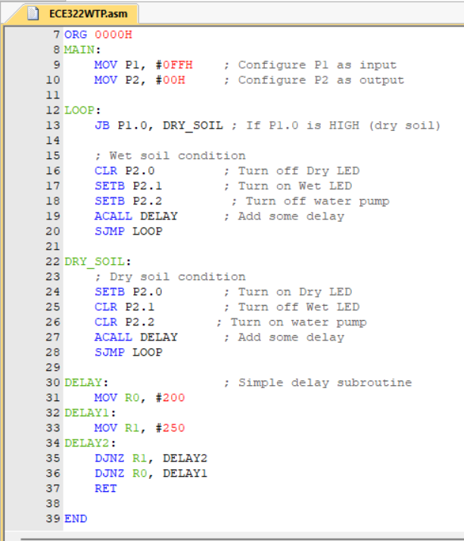


Microcontroller Programming
Thresholds
Irrigation Logic
Defining the upper and lower limits for soil moisture levels that trigger irrigation.
The microcontroller activates the irrigation valve when the soil moisture falls below the lower threshold.

Slide 6


Hardware Implementation
Component Selection
Circuit Design
Choosing appropriate soil moisture sensors, microcontrollers, and irrigation valves for the system's requirements.
Designing the electrical connections and interfacing between components.
1
2

Slide 7


Slide 8
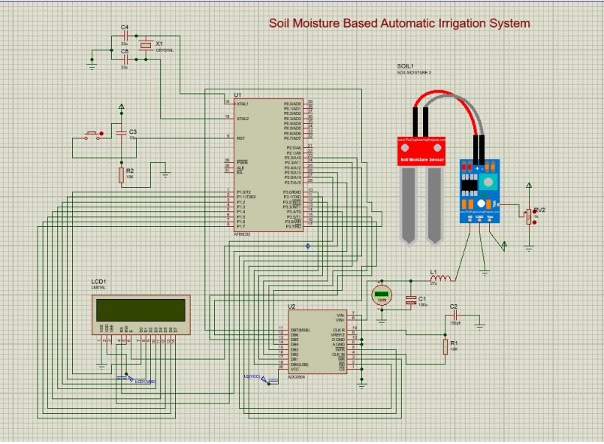

Slide 9
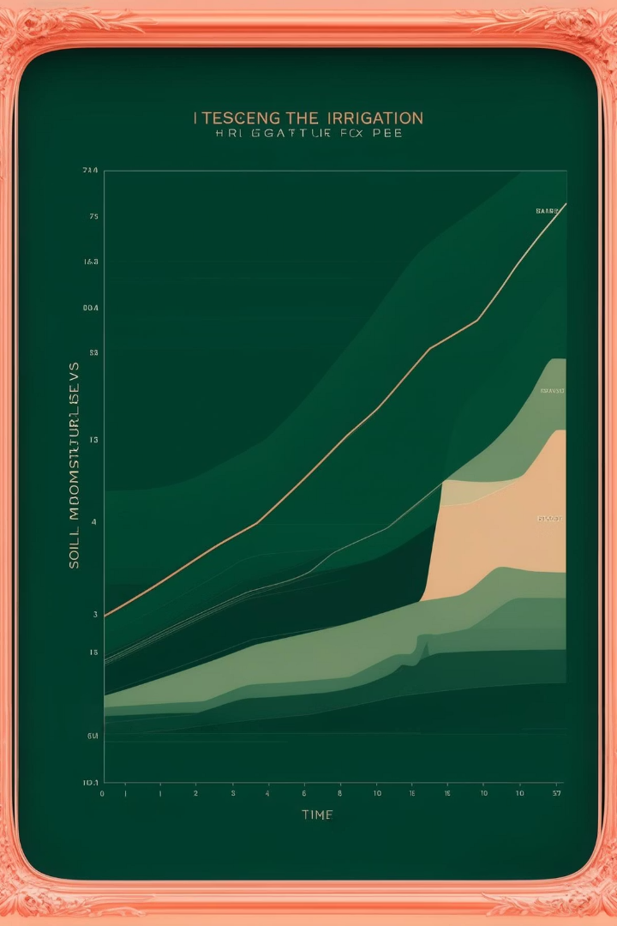
Testing and Results
1
Water Conservation
The system effectively conserves water by only irrigating when necessary.
2
Plant Health
Maintaining optimal soil moisture promotes plant health and growth.

Slide 10
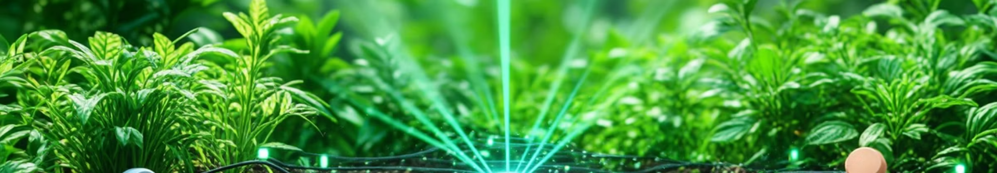



Future Enhancements
Wireless Connectivity
Enabling remote monitoring and control of the irrigation system.
Remote Monitoring
Providing real-time updates on soil moisture levels and system status.
Conclusion
The soil moisture sensor with automatic irrigation system effectively addresses the critical need for water conservation.

